Slide 1

QEL, Spices Board
Lecture - 1
Introduction to instrumentation:
LC-MS/MS
03-Jul-23
In-house Training – 1:
Analysis of Pesticide Residues
Dr. Ramesh BN
Spices Board

Slide 2

Chromatography
HPLC, GC…
A + B
Mixture
Mobile Phase reservoir
Detection System
Stationery phase

Slide 3
HPLC Analysis
Limitations
1
2
3
When conventional detectors are used, identification of unknowns by retention time matching
Possibility of errors
To avoid these errors, we use mass spectrometry along with chromatography
Inject Standard:
Inject Sample:
R.T. Match
Compound 3 present in sample
Problems:
⤷ Two compounds with same Retention Time: FALSE POSITIVE
⤷ Retention Time shift for one compound: FALSE NEGATIVE

Slide 4
Mass Spectrometry
Why?
A mass spectrometer (MS) looks at the masses of the analytes being tested
⤷ Uses information derived from these masses for identification
⤷ High degree of specificity
⤷ Retention time can be used for additional confirmation

Slide 5
MS as a detector
Hyphenated techniques
An MS can function as a detector to a chromatographic system, replacing conventional detectors
⤷ Gas chromatography (GC-MS), liquid chromatography (LC-MS)
⤷ Can provide very specific and sensitive analysis
⤷ Currently, MS is the default detector in trace analysis work
⤷ ‘Tandem’ MS is possible, which gives even more specificity and sensitivity (MS/MS)

Slide 6
Mass Spectrometry
§ General principles

Slide 7
Mass Spectrometry
Principles - 1
A mass spectrometer can ‘see’ only charged entities (ions)
Typically functions under high vacuum
⤷ The ions need a stable path through the mass spectrometer, without colliding with air molecules or with one another
The ‘mean free path’: average distance between collisions for a gaseous ion – must be high
760 Torr
To detector
10⁻⁵ Torr
To detector

Slide 8
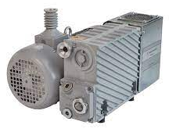
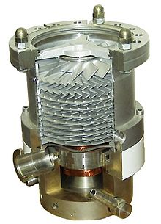
Mass Spectrometry
Principles - 2
In MS the vacuum is achieved in two stages:
⤷ The rouging pump (outside the instrument): from 760 Torr to 10⁻³ Torr
⤷ The turbo molecular pump (inside the instrument): from 10⁻³ Torr to 10⁻⁵ Torr

Slide 9
Mass Spectrometry
Principles - 3
The connection between LC and MS is called the ‘Interface’:
⤷ From HPLC the mobile phase flows out
⤷ MS cannot handle this – it is a vacuum technique
⤷ The liquid mobile phase has to be evaporated and taken into the MS
⤷ Loss of analytes should be kept to a minimum
⤷ In LC-MS, ionization also happens in the interface

Slide 10
Mass Spectrometry
Principles - 4
MS can operate in two ways.
First way:
⤷ Molecule of interest is ionized
⤷ Typically called ‘parent’ ion.
⤷ Number of parent ions can be counted for quantification (LC-MS).
Second way:
⤷ Molecule of interest is ionized, to get the ‘parent’ ion
⤷ Parent ion is broken down into multiple ‘daughter’ ions
⤷ Selected ‘daughter’ ions are counted for quantification (LC-MS/MS)
Why is this useful?

Slide 11
Mass Spectrometry
§ Components and operation

Slide 12
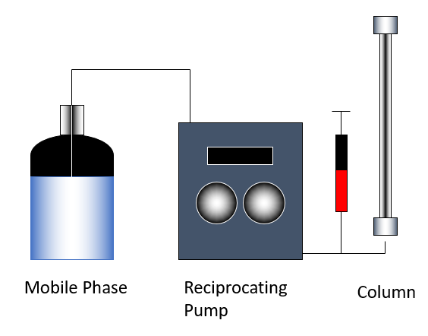
Mass Spectrometry
Components - overview
LC MS/MS
High vacuum
Ionzation
Select
Parent ion
Make daughter ions
Select daughter ion
Count ions
HPLC
LC MS
In LC MS/MS, ionization happens in atmospheric pressure
Ionization is soft: MH⁺ ion is formed
Standard spectrum libraries not possible

Slide 13
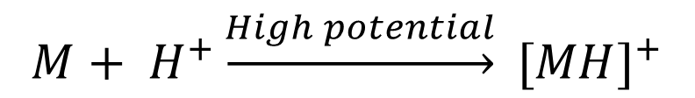
Mass Spectrometry
Ionization
High voltage
~ 5500V
Charged Droplets
Coulomb Explosion
+
+
+
+
vacuum
+
+
+
+
+
+
N₂
+
+
+
-ve
+
+
Evaporation
+
From HPLC
pump
+
+
+
+
+
+
+
+
+
+
+
+
+
+
+
Nebulizer Gas
Heating gas
From solvent
Parent ion
$$M+ H^{+}\underset{→}{High potential} {[MH]}^{+}$$
Used for MS/MS

Slide 14
Mass Spectrometry
Quadrupoles (1)
Four electrodes arranged in a hyperboloid fashion
Two Voltages:
Radio Frequency - RF (alternating)
Direct Current - DC
Applied simultaneously, the two voltages will trap ions within the quadrupole area
Scanning the voltages will filter the ions out by mass:
For one RF:DC value, only one mass can have a stable trajectory through the quadrupole
When RF:DC is progressively increased (scanned) Ions pass through in the order of masses
RF

Slide 15
Mass Spectrometry
Quadrupoles (2)
Opposite electrodes of the Quadrupole have the same potential
The potential alternates with the same frequency as the RF Voltage
-
+
+
-
+
-
-
+

Slide 16
Mass Spectrometry
Quadrupoles (3)
-
The ion oscillates in the volume between the quadrupoles
A negative potential at the exit end of the quadrupole can the be used to pull the ion through the quadrupole
+
+
-
-
+
+
+
-
+

Slide 17
Mass Spectrometry
Mass analysis by the quadrupoles (1)
DC
RF
When RF and DC are applied together, Quadrupoles function as a mass analyzer.
The RF-DC voltages can be scanned
DC voltage increases with time
RF amplitude increases with time, but frequency remains constant
For one RF-DC combination, only an ion of one particular mass will have a stable trajectory through the quadrupoles.
Technically, it is the mass/charge (m/z) that is affected
High mass
Voltage
Low mass
Time

Slide 18

Mass Spectrometry
Mass analysis by the quadrupoles (2)
m₅
m₄
RF-DC combinations in the quadrupole can be used to filter ions by mass:
⤷ Low RF-DC combination, ions of low mass transmitted.
⤷ High RF-DC combination, ions of high mass is transmitted
m₃
m₂
m₁
Voltage
Time

Slide 19
Mass Spectrometry
Mass analysis by the quadrupoles (3)
Quadrupoles can function in two modes
⤷ Fixed RF-DC : Only ions with a fixed mass will be transmitted
⤷ Switching DC off, i.e. RF only:
⤷ All ions oscillate within the quadrupole
⤷ By keeping a potential at the other end of the quadrupole, all ions can be transmitted together through the quadrupole

Slide 20
Mass Spectrometry
Detection of ions
Electron Multiplier
⤷ The sides of the detector are coated with material that produces electrons on impact by charged particles
+
Detectable Current

Slide 21
Mass Spectrometry
Putting everything together
Multiple Reaction Monitoring
Based on the theory that, under the same conditions,
An ion from an analyte will always fragment in the same way
Fragmentation pattern wIll be unique
Highly selective and sensitive
We can choose to look at only molecules of interest
Quantification in ppb levels

Slide 22
Mass Spectrometry
Putting everything together (2)
Three Quadrupoles:
First Quadrupole will select the parent ion MH⁺
Second Quadrupole functions as the collision cell:
N₂ is infused into the collision cell
Daughter ions produced by Collision Induced Dissociation (CID)
Third Quadrupole scans the daughter ions
Linear ion trap:
Second quadrupole ejects all ions except the most intense ion
Can study how this ion behaves with time
Trapped ion can be fragmented further by CID
We have AB Sciex Qtrap® instrument at QEL Kochi but we are not using it in routine analysis
N₂

Slide 23
Mass Spectrometry
Putting everything together (3)
RF/DC Fixed – Only
One daughter ion
Collision Induced Dissociation
RF Only: Transmit
+
+
+
Select the parent ion
Of interest: Fixed RF:DC
+
+
+
+
+
+
M
Ionization
IQL1
Q1
IQL2
Collision Cell
Q2
IQL3
Q3
Detector

Slide 24
Mass Spectrometry
§ in practice

Slide 25
Multiple Reaction Monitoring
Quantitative analysis using MS/MS
“Transitions”
[M₁H]⁺ → D₃
LC MS/MS
M₁ + H⁺
[M₁H]⁺
N₂
D₁
D₂
D₃
.
.
Count
Multiple such reactions, or transitions, can be anaysed in a single run – hence the name ‘MRM’

Slide 26
Multiple Reaction Monitoring
Quantitative analysis using MS/MS (2)
In MRM, we choose 2 transitions per analyte
⤷ Higher intensity transition is called the quantifier, and is used for quantification
⤷ Lower intensity transition is called the qualifier
⤷ Quantifier : Qualifier ratio should match between standard and sample
 | Compound | Parent Ion | Daughter Ion | Type | Ratio
LC MS/MS | Ethion | 385 | 199 | Quantifier | 28.6
 |  | 385 | 171 | Qualifier

Slide 27
MS/MS scan modes
Not just MRMs
M₁
Q1
Q2
Q3
Detector
Product ion scan
M₂
d₁,d₂,d₃
d₁,d₂,d₃
To understand the ways in which an ion can fragment. First step in MS method development
M₁
M₃
Fixed m/z
Scan
M₁
Selected ion monitoring
MRM mode,
Mainly used for quantitation work
M₂
M₁
d₁,d₂,d₃
d₁
M₃
Fixed m/z
Fixed m/z
M₁
Neutral loss
Scan
M₂
d₁,d₂,d₃
d₁-x
d₂--x…
M₁,M_{2,}M₃
d₄,d₅,d₅
To study reaction mechanisms
M₃
Scan
(only ions that lost an x fragment)
Scan
M₁
Precursor ion
Scan
M₁,M_{2,}M₃
d₁,d₂,d₃
d₁
To find which ions (precursors) produce a given daughter ion
M₂
d₄,d₅,d₅
M₃
Scan
Fixed m/z

Slide 28
Topics that remain to be covered
in LC-MS/MS
Mass accuracy and resolution, calibration of mass-response, MS tuning
⤷ Will be covered in the method validation class
Basic troubleshooting in LC-MS/MS
⤷ There will be a separate class on this

Slide 29
More to learn..
Next session 10th June 2023
✅
(1) Introduction to instrumentation: LC-MS/MS, 03-Jul-23
(2) Introduction to instrumentation: GC-MS/MS, 10-Jul-23
(3) Pesticide residue analysis - Introduction, 17-Jul-23
(4) Advanced pesticide residue analysis, 24-Jul-23
(5) Method validation: requirements and practice, 31-Jul-23
(6) Introduction to measurement uncertainty calculation, 7-Aug-23
🕑
🕑
🕑
🕑
🕑

Slide 30
Dr Ramesh BN
Scientist C, Spices Board
Thank you!
WhatsApp
Mobile
Email (O)
Email (P)
Course website
:
:
:
:
:
+91 8547662471
+91 8547662471
rameshbabu.n@nic.in
rameshbn1@gmail.com
http://ramesh.-sb.github.io
§ Questions?

